Slide 1












Signa Automata

Slide 2


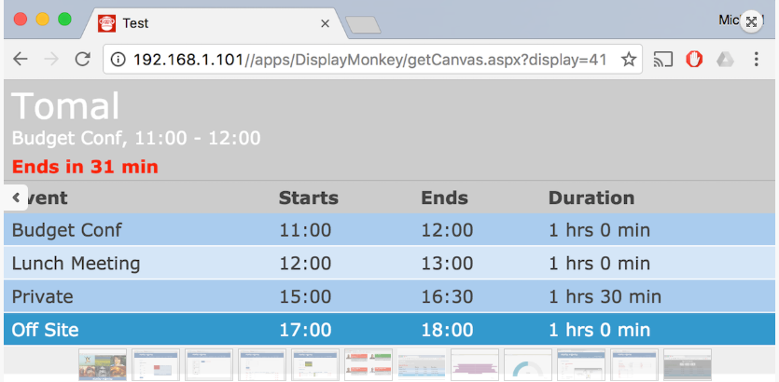
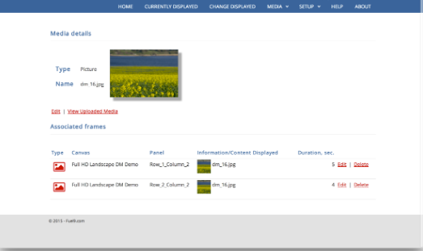
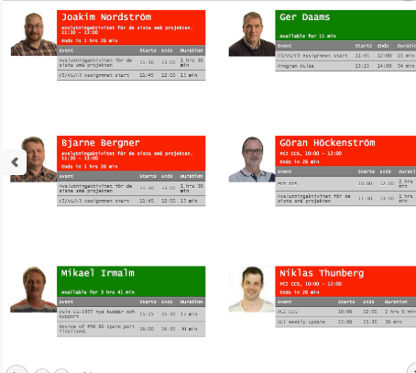



Overview

Slide 3


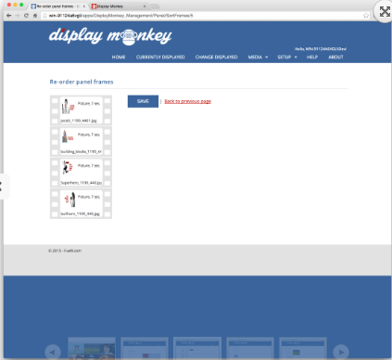

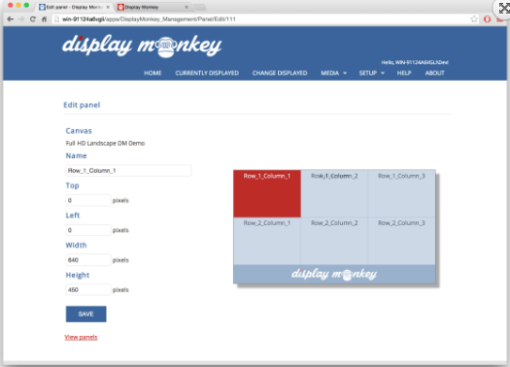

SQL Reporting Services
Show sales, financial or other types of KPI’s to display up-to-date information. Unlimited number of SQL Server Reporting Service servers may be connected.
Images
Show sales, financial or other types of KPI’s to display up-to-date information. Unlimited number of SQL Server Reporting Service servers may be connected.
Youtube
Link your YouTube videos with full control of settings like sound, aspect ratio and video quality
Video
Upload and share videos. Most common video formats are supported. Play video in full screen or in a user defined panel with or without sound.

Slide 4




HTML 5
Show sales, financial or other types of KPI’s to display up-to-date information. Unlimited number of SQL Server Reporting Service servers may be connected.
Memo
Enter simple memos which will be displayed in a pre-formatted way. Memo’s includes subject line and body section.
Hierarchies
You can organize your displays into groups and hierarchies to enable specific content to be shown only in certain location or locations.
HTML Messages
Use the WYSIWYG HTML editor to create fully customizable messages like a cafeteria menu or a visitors welcome screen.

Slide 5




Valid From/To
Any content can be displayed from and to any specific date and time making it easily managed.
Exchange/Outlook
Connect your exchange server and show calendars information like availability outside conference/meeting rooms and offices. Book a meeting room with the Quick Book feature.
Flexible Layout
Full screen, two or more panels, sizes and placements. You are in total control how information is displayed on screens.
Location Support
Date and time formatting, weather, current time and more. All based on the displays geolocation for easy management.

Slide 6




Cache
Display Monkey comes with built in caching functionality to speed up delivery of content and reduce strain on network resources.
Technology
Designed and built on the latest web and database technologies. Dot.Net 4.x web server and content stored in MS SQL database makes a robust and cutting edge platform.
CSS Templates
Built in support CSS templates that will change look & feel of presentations. Create one or more templates for every type of content.
Power BI
Connect to Azure/Power BI portal and show your existing Power BI reports and Tiles in hallways and conference rooms.

Slide 7


Thanks!
Any questions?
You can find me at:
@username
user@mail.me

